Slide 1
OpenChain Project
Today, Tomorrow, Community

Slide 2
Today

Slide 3














1H 2025 Overview
New Platinum Member:
ISO/IEC 5230 Co-Announcements:
Recertification Co-Announcements:
ISO/IEC 18974 Co-Announcements:
Proposed updates to ISO/IEC 5230 and ISO/IEC 18974 finished public comments and freeze periods, moved to Steering Committee.
Maturity models released.
“Explainers” for company departments released.
Open source policy template updated.
Telco SBOM Quality Guide updated.
AI BOM Compliance Guide complete, board approval pending.
Cross-industry SBOM quality guide early drafting.
Reorganized reference library of 1,500~ resources. Better discoverability of processes
Improved integration with other LF Project activities (e.g. OpenSSF).

Slide 4

Welcome Our Latest Platinum Member!

Slide 5


25 Platinum Members (Governing Board)
Jimmy Ahlberg Ericsson
Members Represent Trillions In USD Market Value

Slide 6
S-Core Adopts ISO/IEC 18974
(They Adopted ISO/IEC 5230 in February)

Slide 7




Korean ISO/IEC 18974 Adoption Is Excellent!

Slide 8
OpenAnolis Adopts ISO/IEC 5230

Slide 9


Chinese Operating Systems Love OpenChain

Slide 10
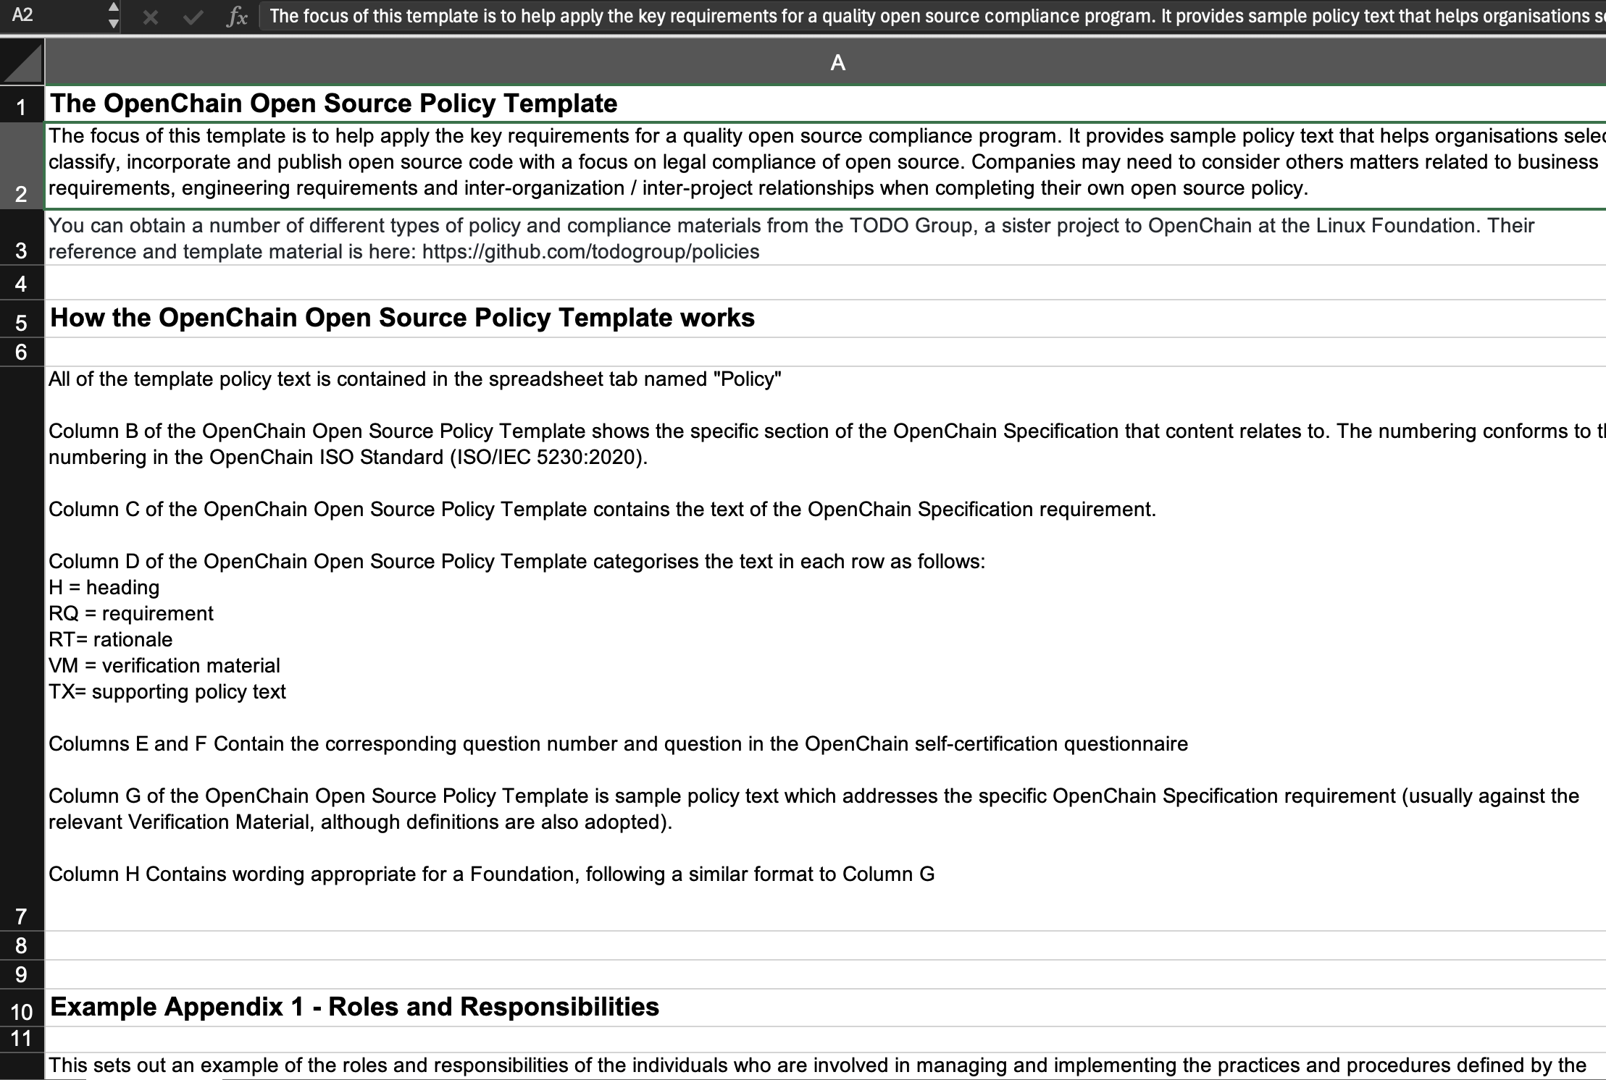
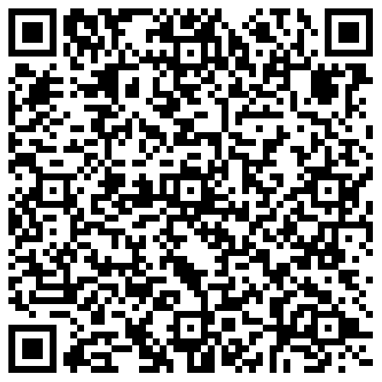
Updated Policy Template

Slide 11
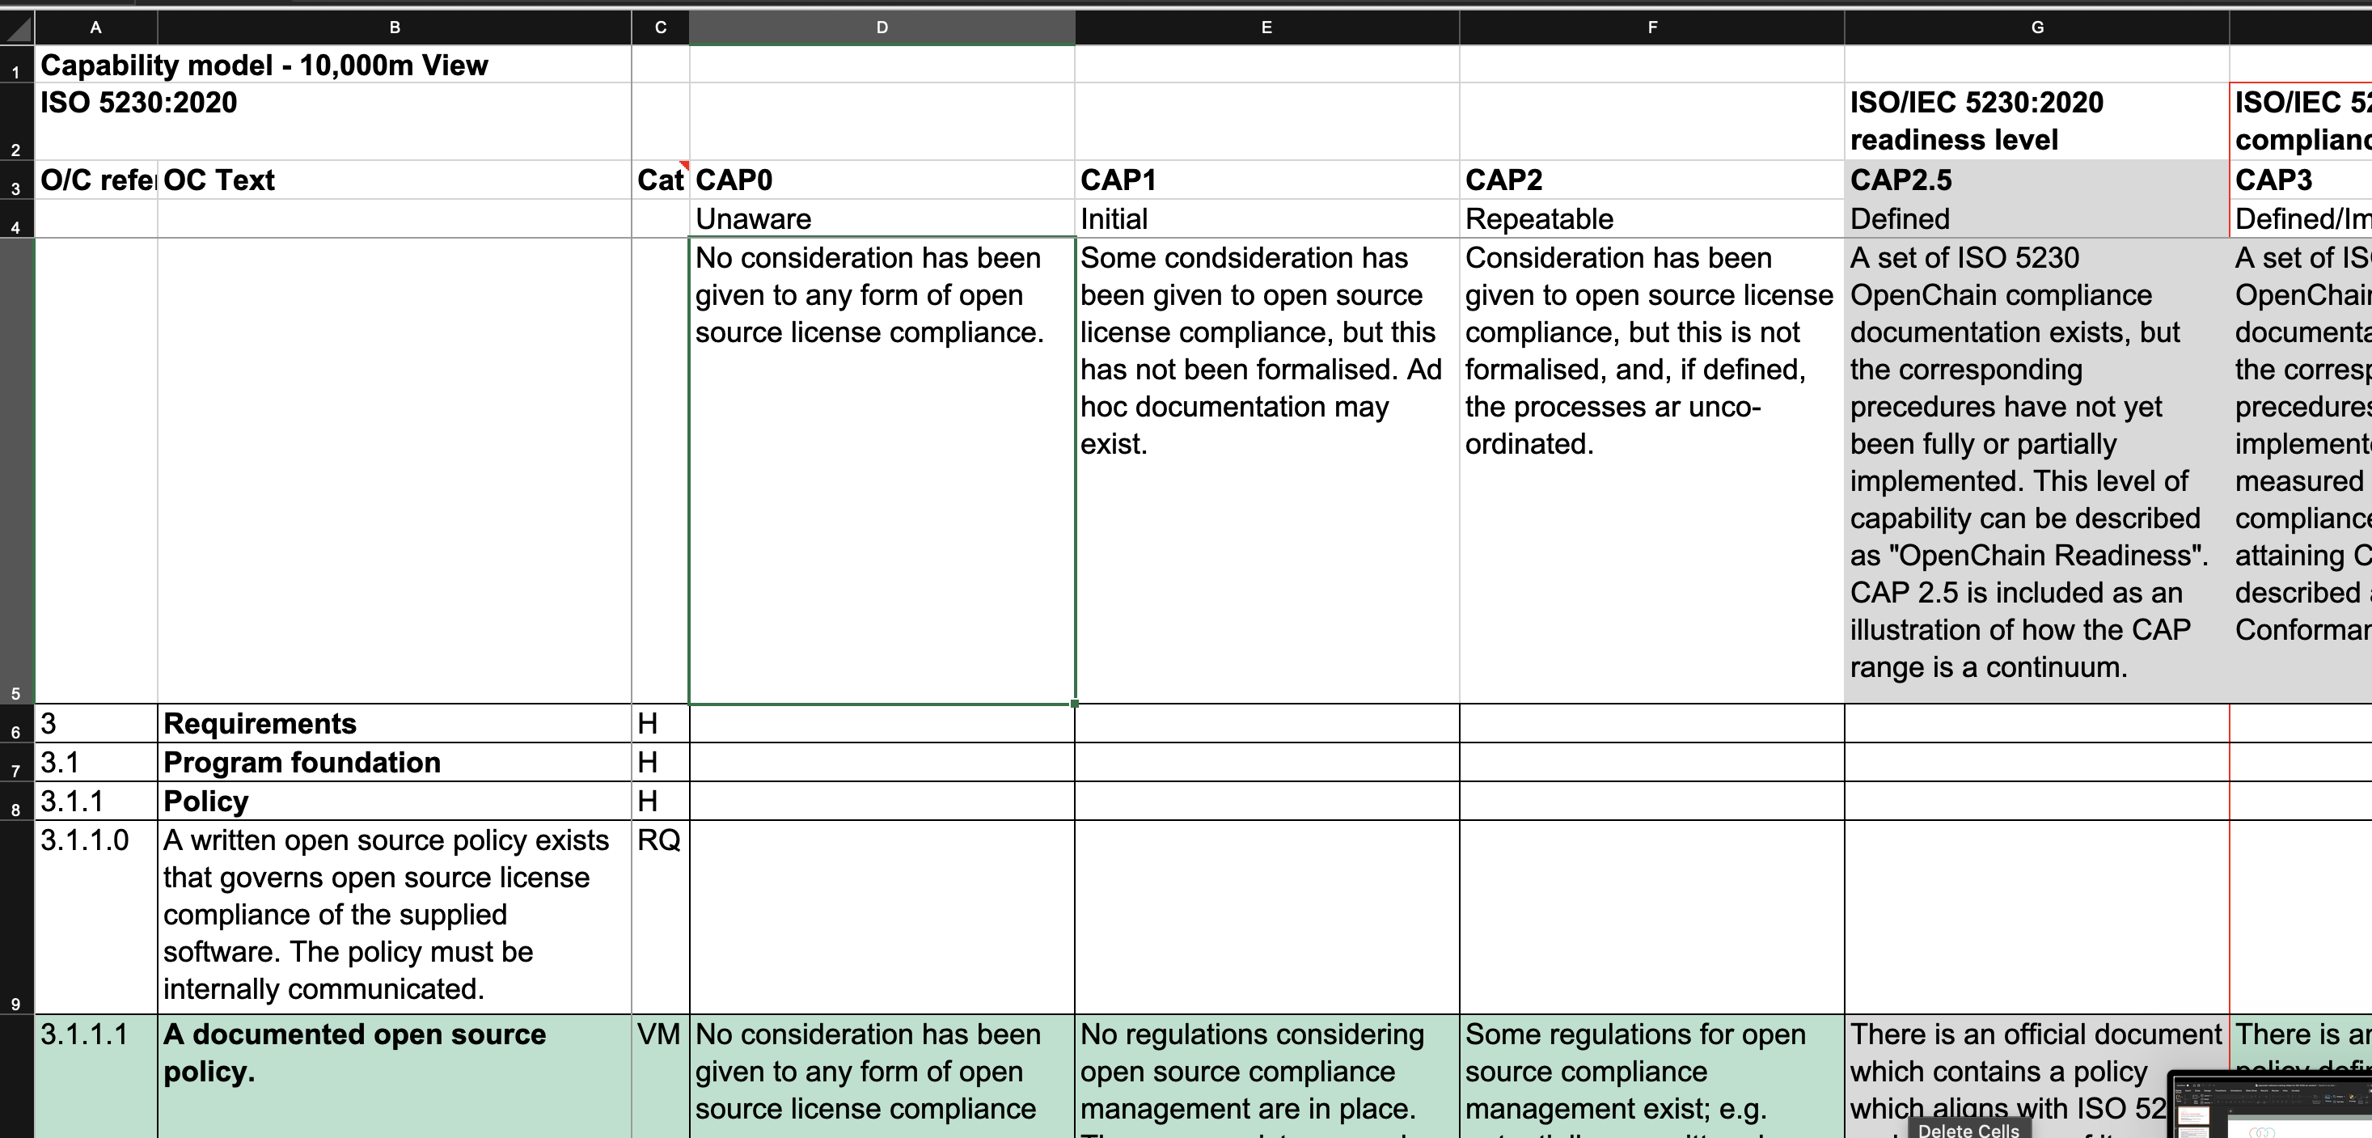

Updated Capability Model

Slide 12
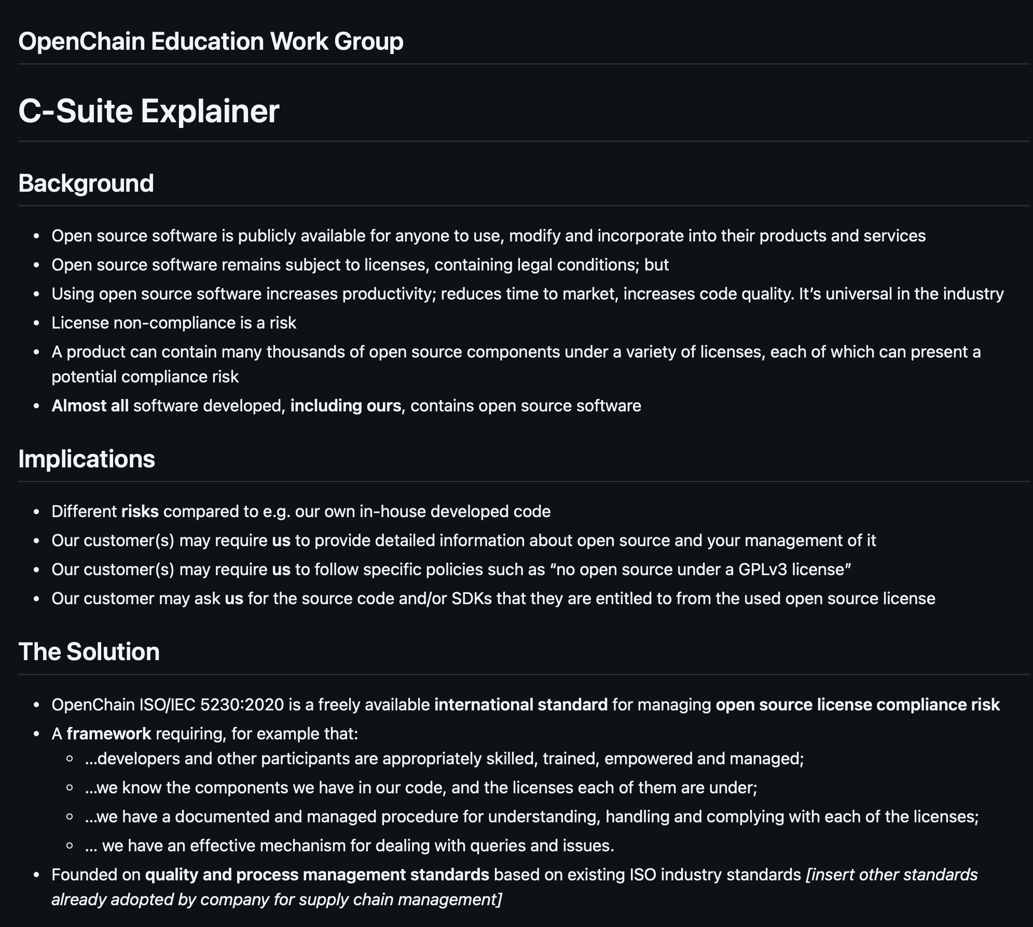
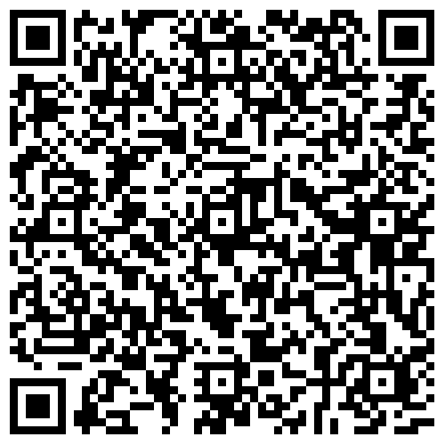
New Explainers

Slide 13
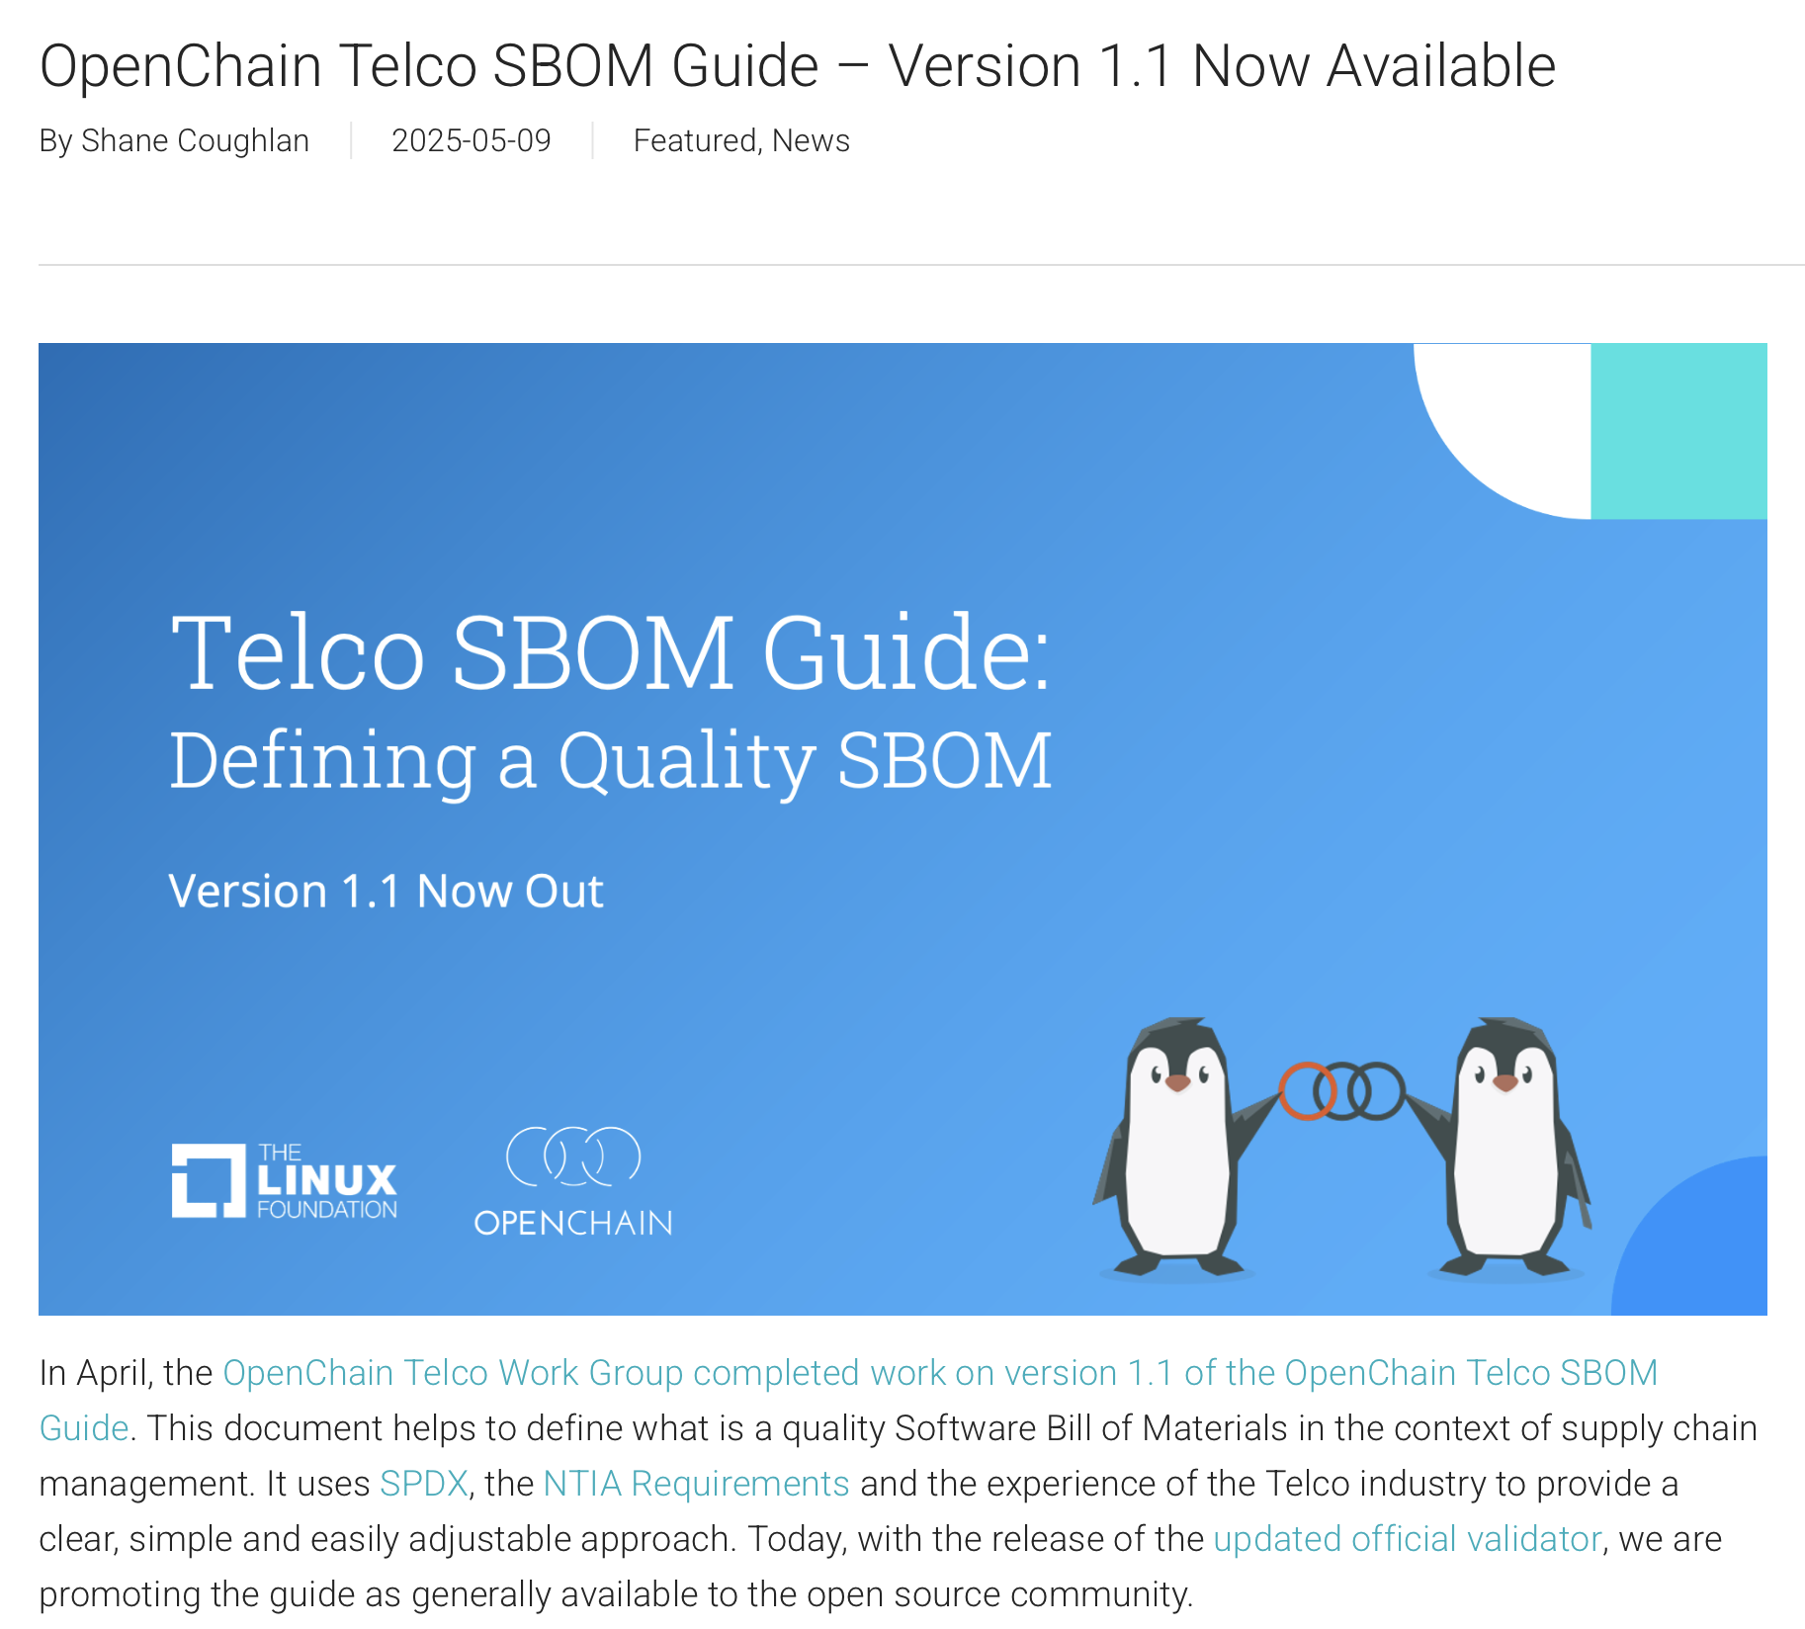
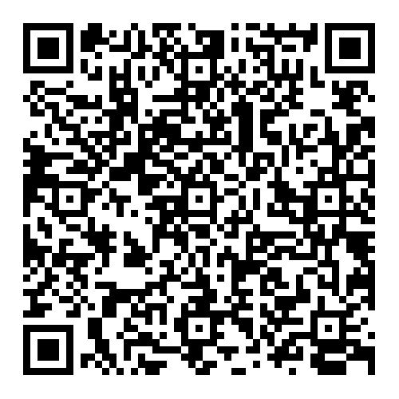
Updated Telco SBOM Quality Guide

Slide 14
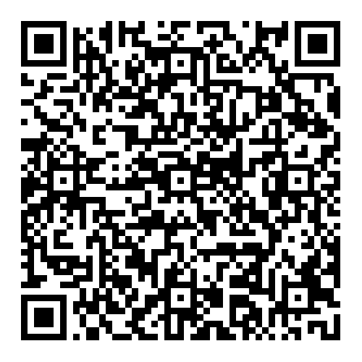
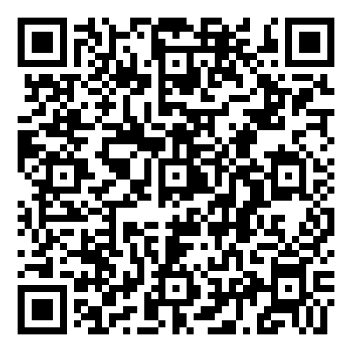
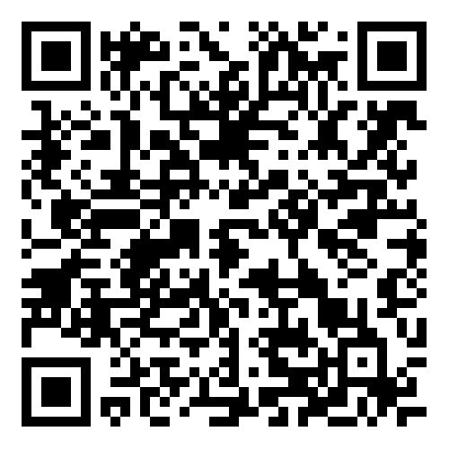
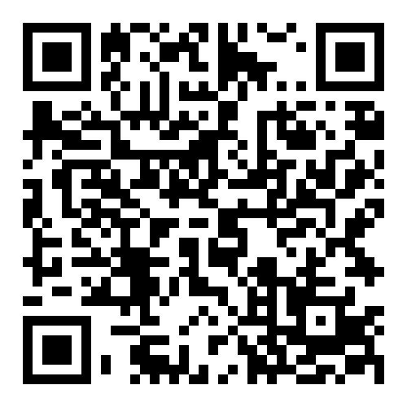
Telco SBOM Quality Work … EXPANDED
Official Validator
Third-Party Tooling
ByteDance Case Study
ByteDance Schemas

Slide 15

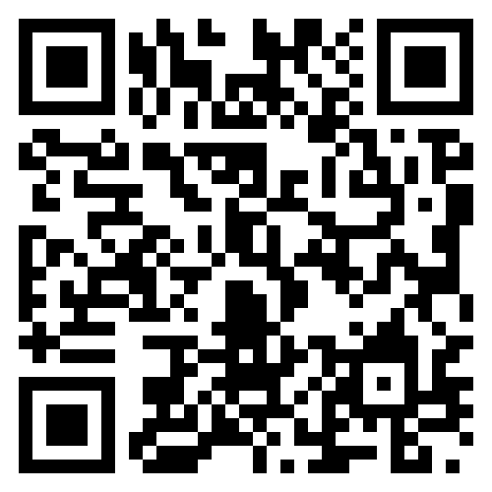
Easier To Find Our Processes

Slide 16
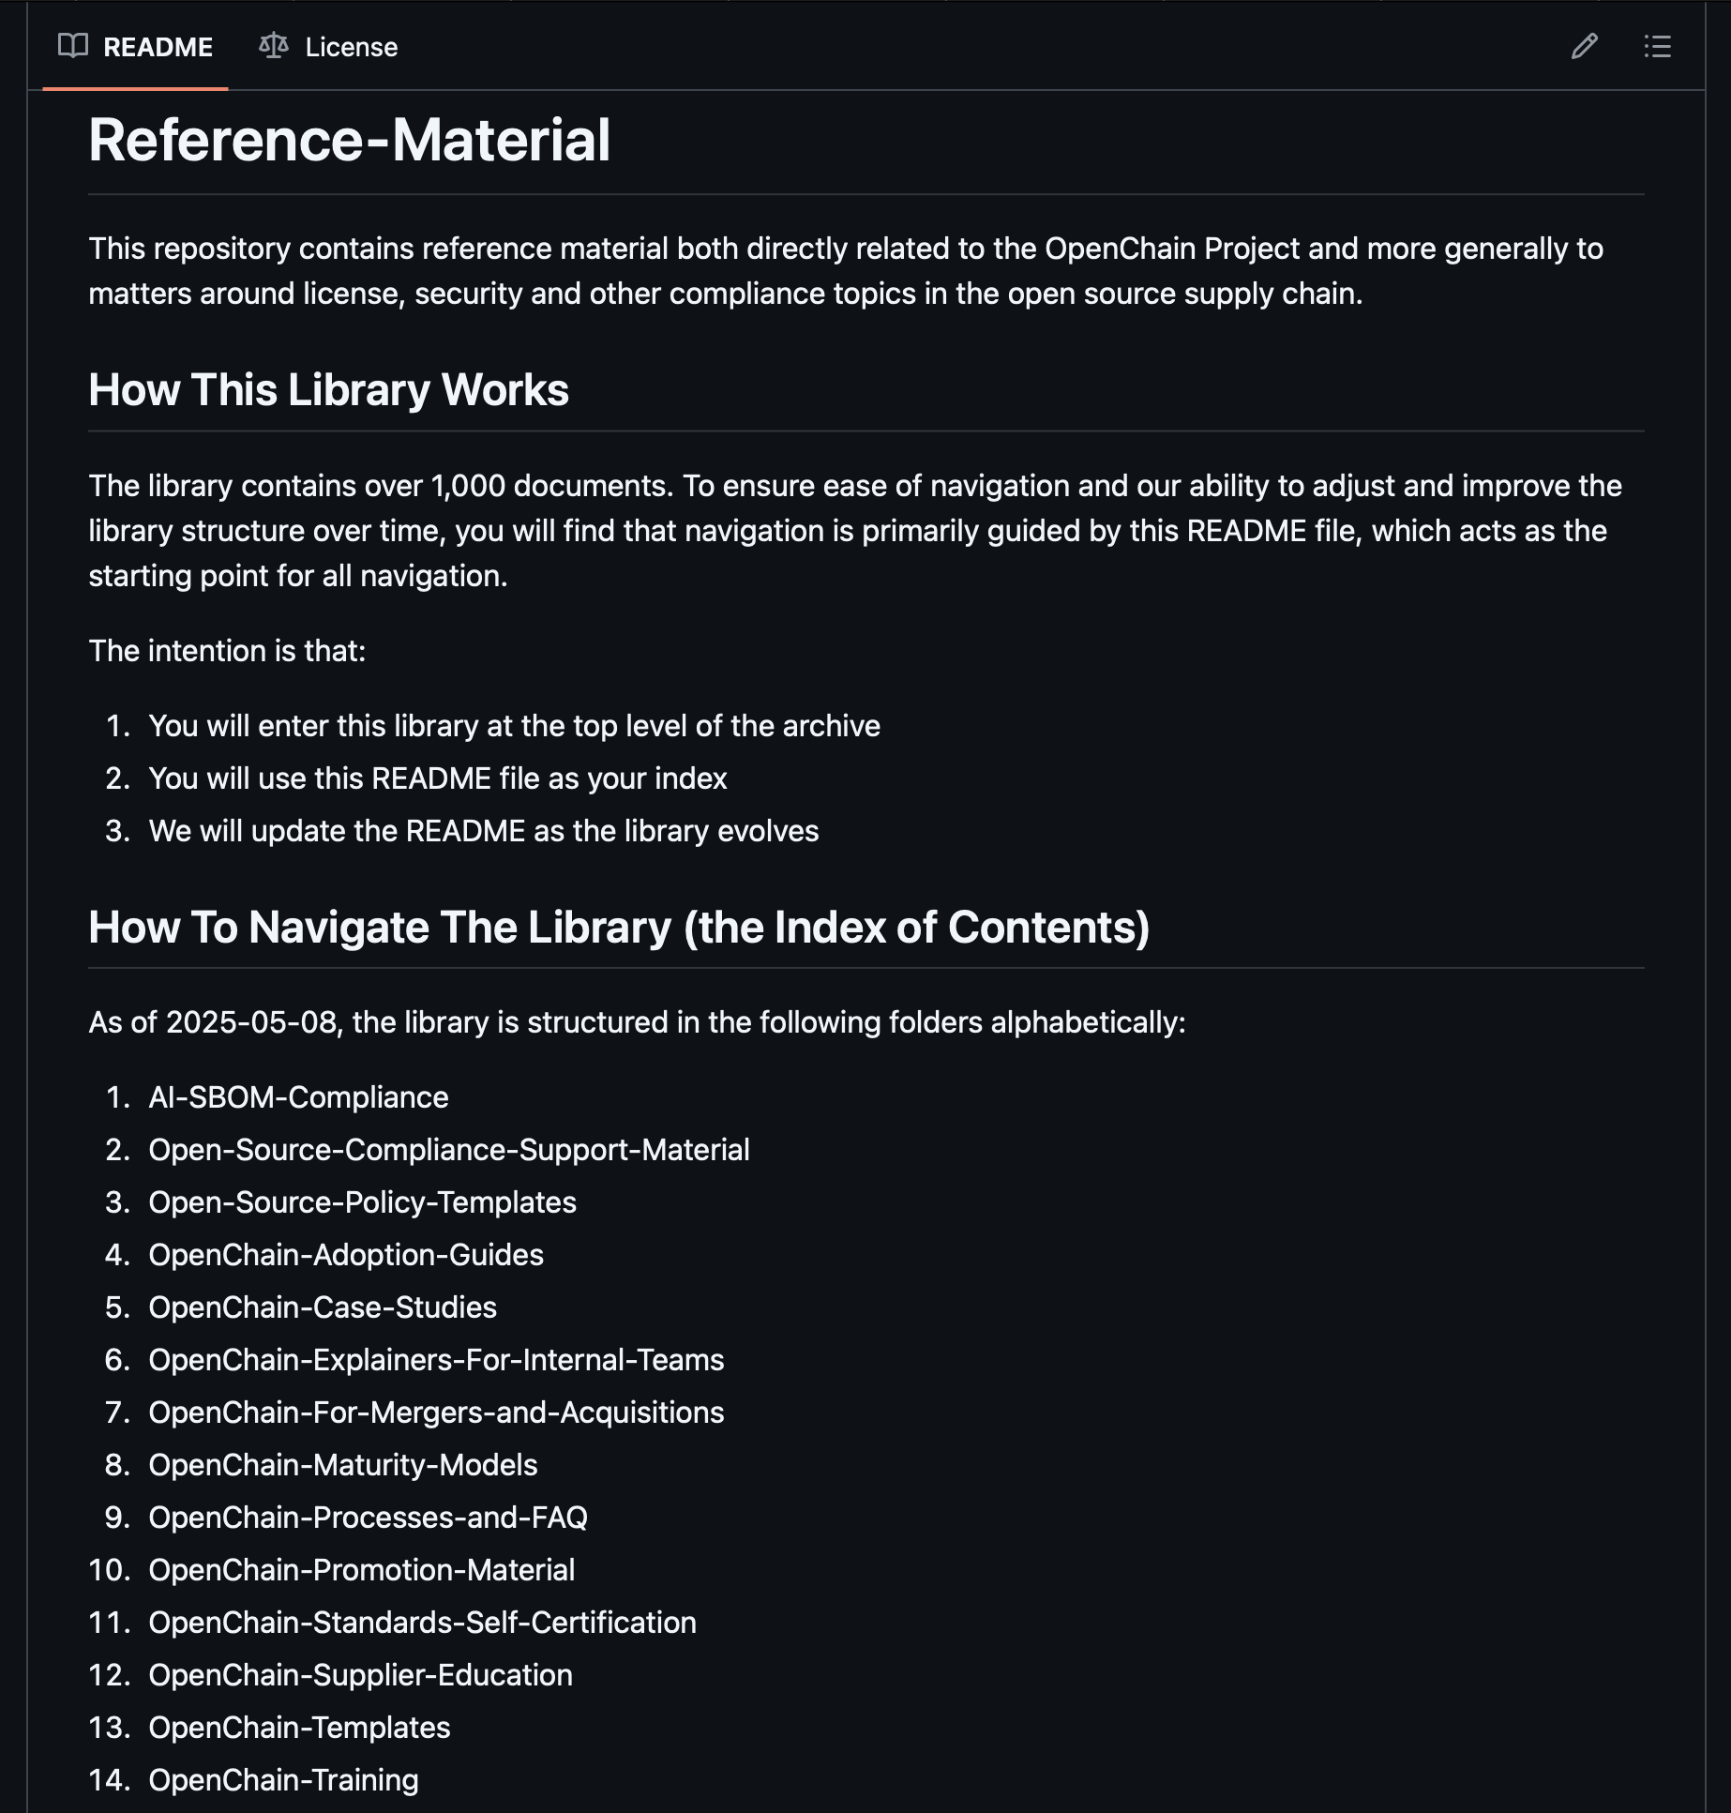

A Reorganized Library

Slide 17
Tomorrow

Slide 18

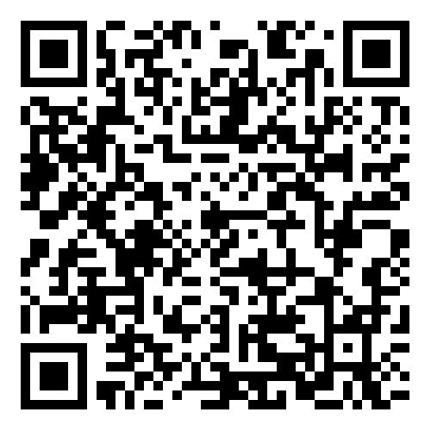
Proposed Updates To Our Existing Standards
Chris Wood Lockheed Martin
Suggestions for updates were collected over a 2-year period
There was a 6-month public comment period
There was a 3-month freeze period
The proposals will now go the Steering Committee on 2025-06-25 for review and formal decisions.

Slide 19


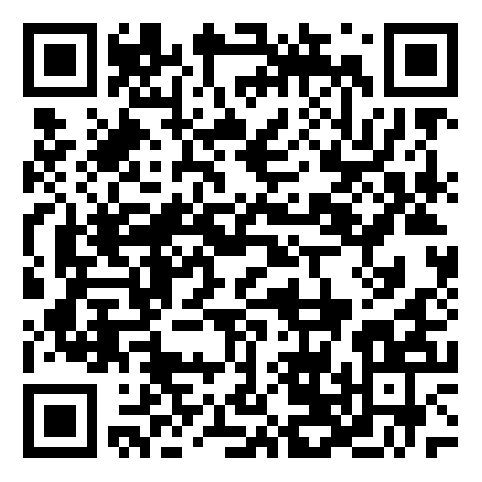
AI Compliance Draft Guide Ready
Dave Marr
Qualcomm
Matthew Crawford
Arm
We held our regular workshop for the OpenChain AI Work Group on May 6th. During this meeting some important decisions were made. The Work Group attendees agreed that initial drafting on the AI SBOM Compliance Guide is now substantially complete, and there will be two next steps:
Asking for formal approval to start a public comment period from the Governing Board today.
If approval is given, the guide will go into a six-week public comment period, and after that period will move into a publication process.
The Draft AI SBOM Compliance Guide:
https://docs.google.com/document/d/1XHztgMALwnu2D02bmWYyXeW3wE_Jw199/edit#heading=h.x3i92tls8mld
Last Meeting:

Slide 20
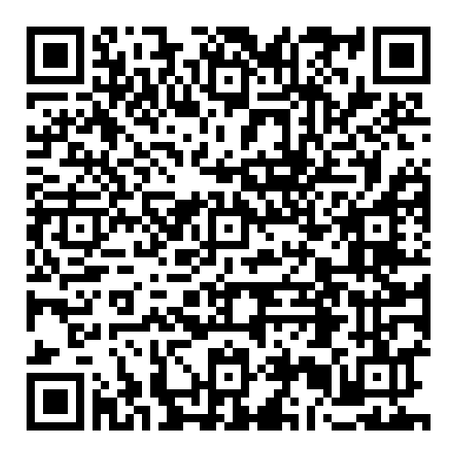
AI BOM Compliance in the Supply Chain Guide

Slide 21

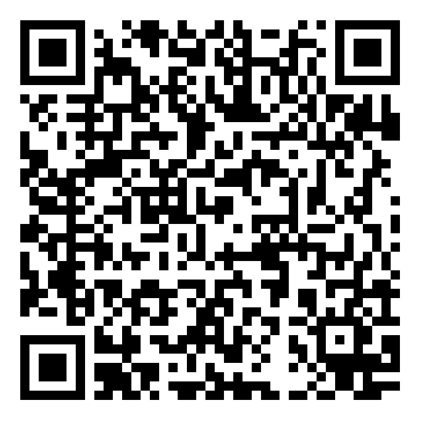
SBOM Study Group Update
Kobota San Sony
The SBOM Study Group has continued its discussion around SBOM Quality. There are two key items framing the discussion:
The release of Version 1.1 of the Telco SBOM Quality Guide: https://openchainproject.org/featured/2025/05/09/openchain-telco-sbom-guide-version-1-1-now-available
The development of a ”thinking” document considering how a cross-industry, cross-format SBOM quality could be structured: https://github.com/OpenChain-Project/SBOM-sg/blob/main/Cross-Industry-SBOM-Quality-Guide/en/Cross-Industry-SBOM-Quality-Guide.md
Suggest approach = family tree: Cross-Industry > Industry Specific Guides (in practice starting with Telco Guide as basis)
Last Meeting:

Slide 22
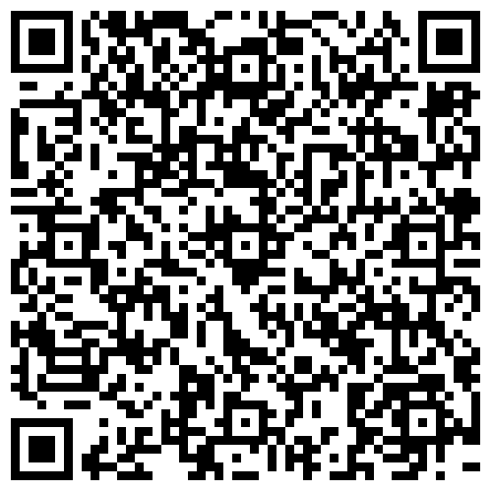
Cross-Industry SBOM Quality Guide Concept

Slide 23
Community

Slide 24

Our Community Study and Work Groups
Core Work Groups
Education (Autumn 2020~)
Specification (Spring 2016~)
Community Work Groups
AI (January 2024~)
Automation (Summer 2019~)
Community Study Groups
SBOM (July 2024~)
Industry-Specific Work Groups
Automotive (Summer 2019~)
Telecom (Spring 2021~)
Regional User Groups
China (Sept 2019~)
Germany (Jan 2020~)
India (Sept 2019~)
Japan (Dec 2017~)
Korea (Jan 2019~)
Taiwan (Sept 2019~)
UK (June 2020~)

Slide 25
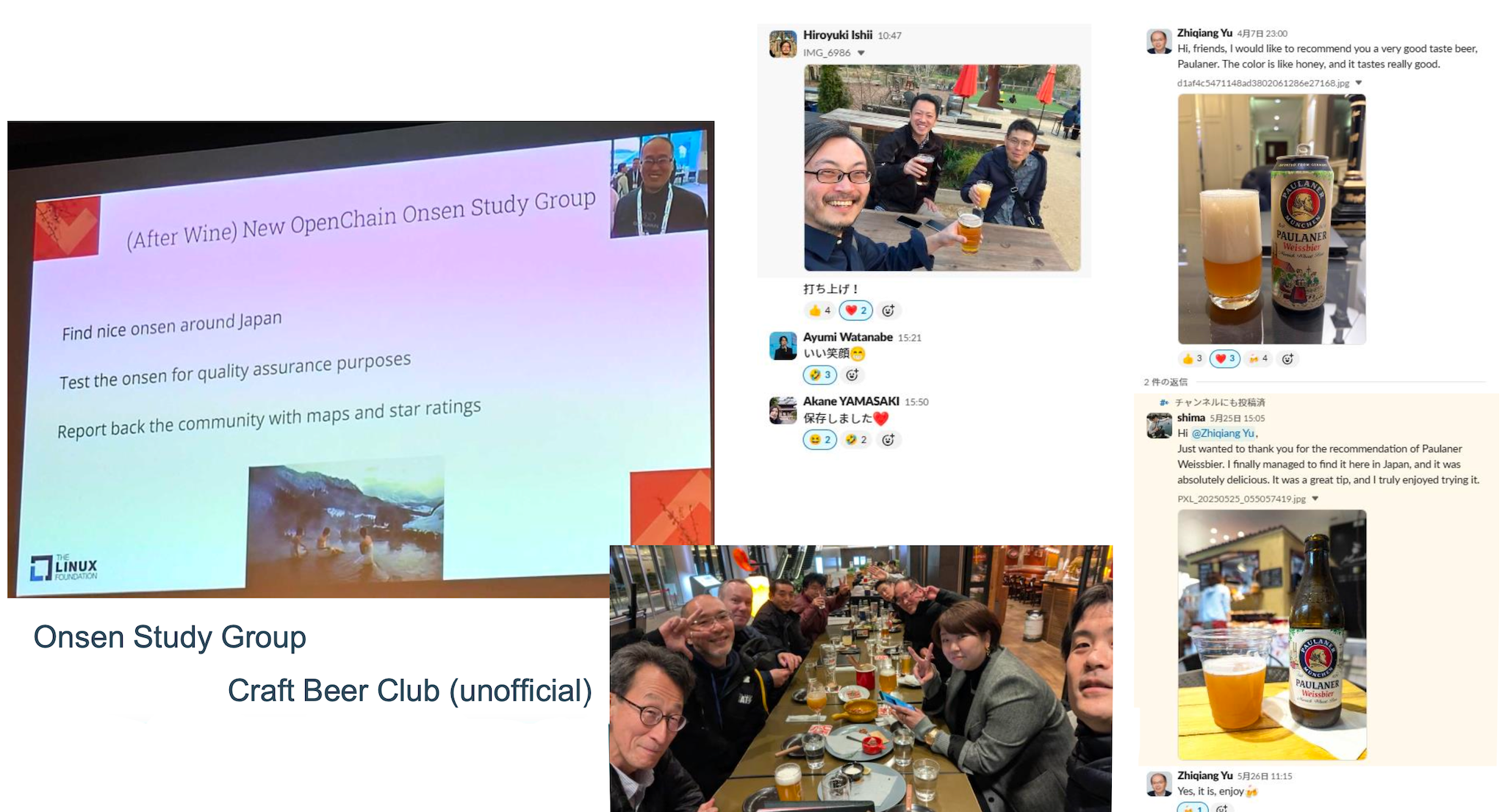
We Are Always A Welcoming Community!

Slide 26
Always Here To Help

Slide 27
Appendix: Proposed Updates to ISO/IEC 5230 and ISO/IEC 18974

Slide 28
Proposed Updates To Our Existing Standards
Our existing ISO/IEC Standards (ISO/IEC 5230 and ISO/IEC 18974) are developed openly on monthly calls and other mechanisms for people to provide feedback. Proposals for potential updates to offer refinements or improvements were collected from the community over a period of two years.
This was done using the formal processes outlined in our processes page. The public comment and freeze periods are now complete. The next step is for the Steering Committee to review and decide about whether to accept the community proposals.

Slide 29
Review of suggested changes to ISO/IEC 5230
Current ISO standard:
https://github.com/OpenChain-Project/License-Compliance-Specification/blob/master/ISO-5230-2020/en/ISO-5230-2020.md
Current Next Generation Draft (pre-public comments period):
https://github.com/OpenChain-Project/License-Compliance-Specification/blob/master/3.0/en/openchain-license-compliance-3.0.md
All open issues have been closed by the Specification Work Group
https://github.com/OpenChain-Project/License-Compliance-Specification/issues?q=is%3Aissue+is%3Aclosed
Next:
The six month comment period and three month freeze period have been completed. It is up to the Steering Committee to decide if we proceed with the changes, and on what timescale.

Slide 30
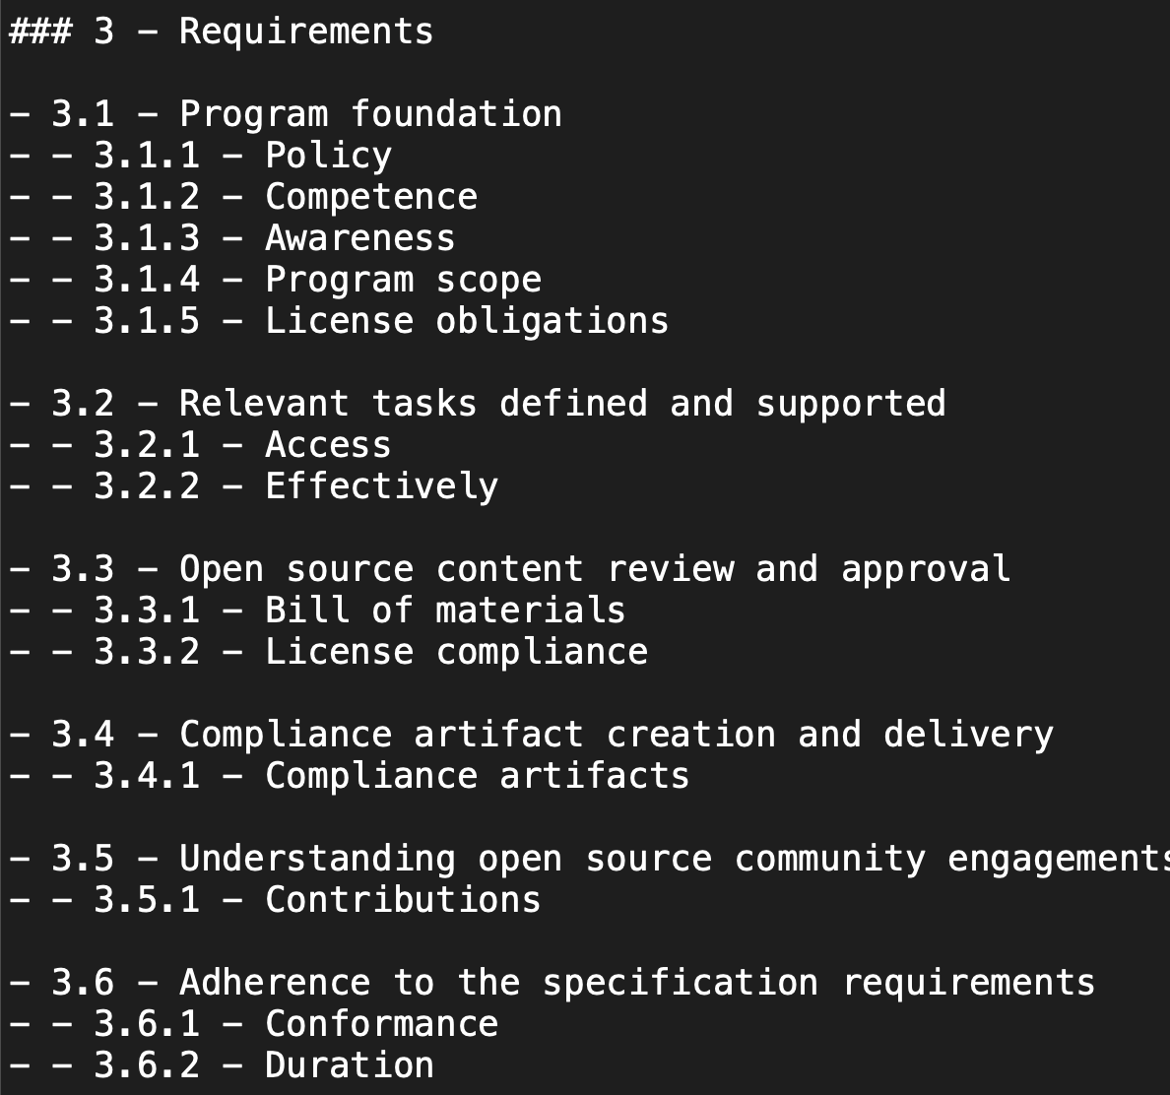
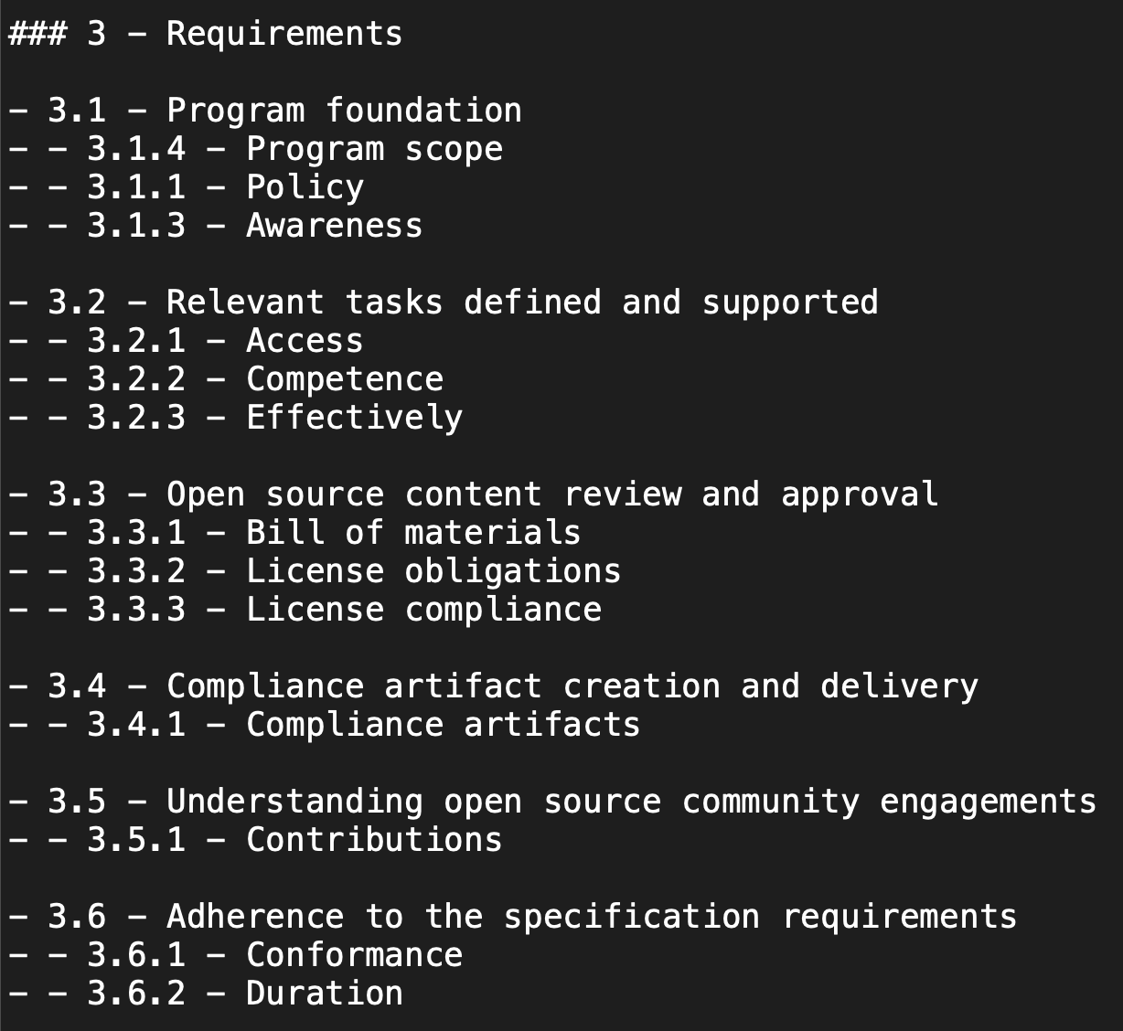
Suggestion #1 for ISO/IEC 5230:2020

Slide 31
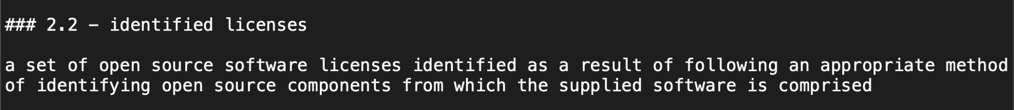
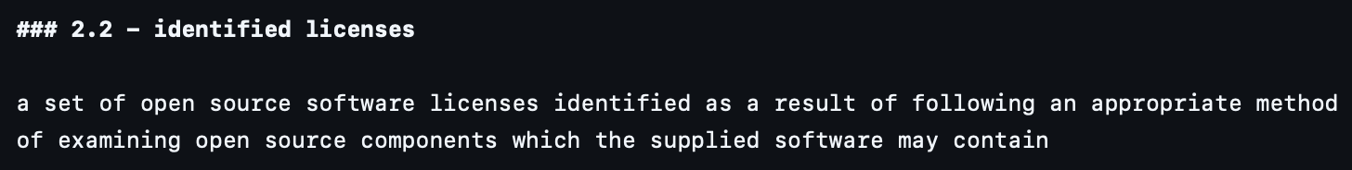
Suggestion #2 for ISO/IEC 5230:2020

Slide 32
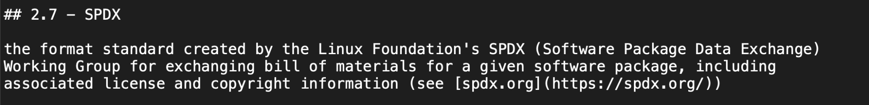
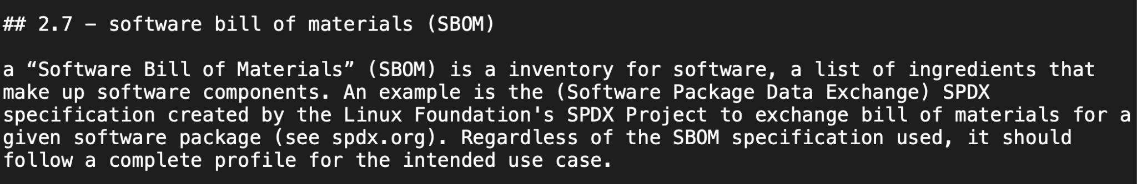
Suggestion #3 for ISO/IEC 5230:2020

Slide 33
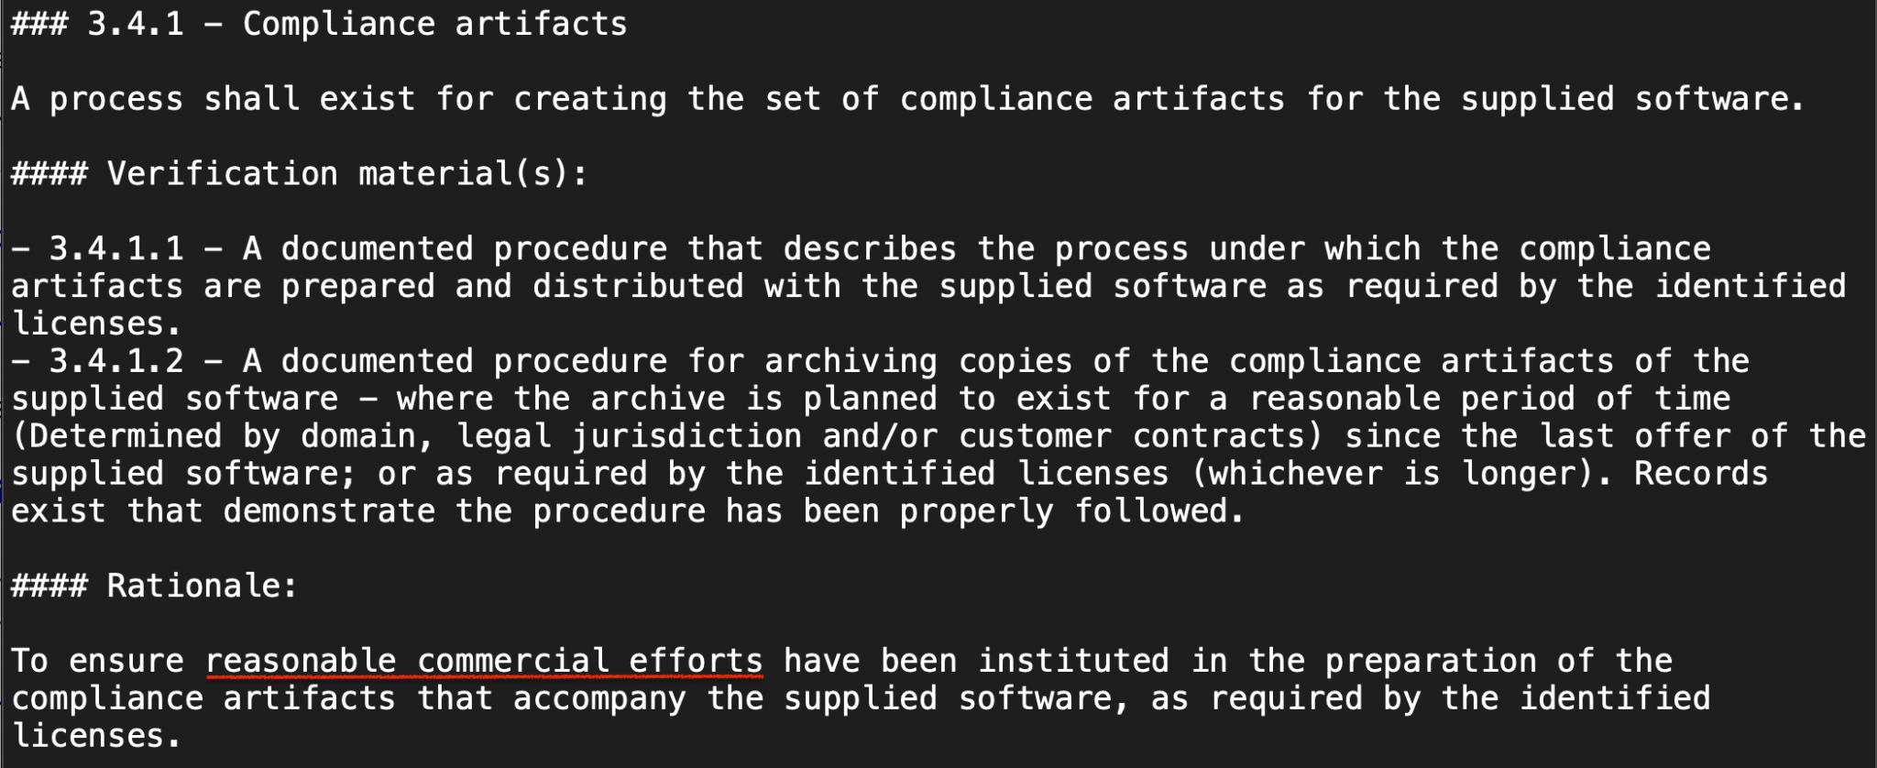
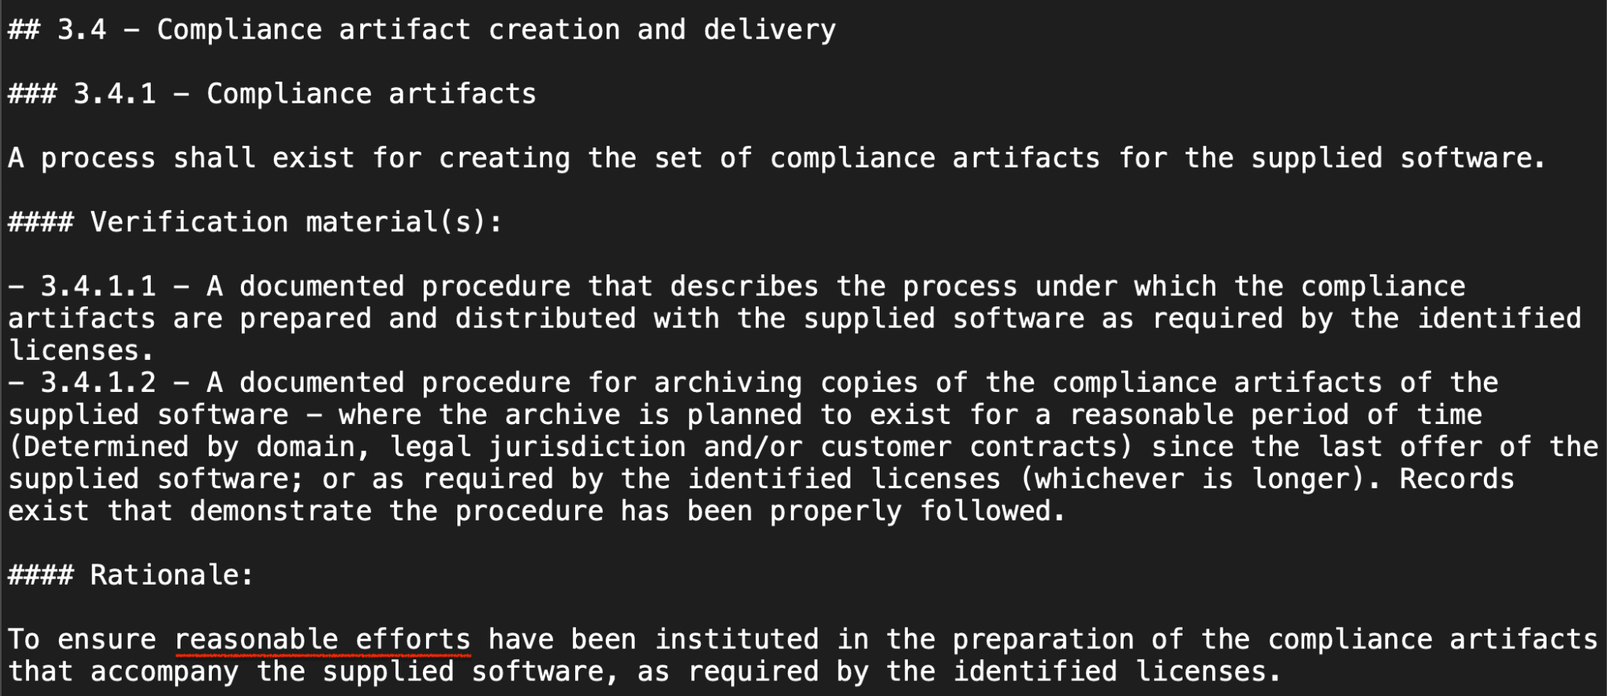
Suggestion #4 ISO/IEC 5230:2020

Slide 34
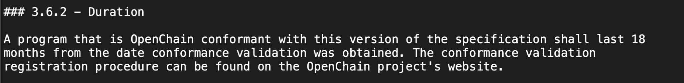
Suggestion #5 for ISO/IEC 5230:2020

Slide 35
Review of suggested changes to ISO/IEC 18974
Current ISO standard:
https://github.com/OpenChain-Project/Security-Assurance-Specification/blob/main/Security-Assurance-Specification/ISO-18974/en/ISO-18974.md
Current Next Generation Draft (pre-public comments period):
https://github.com/OpenChain-Project/Security-Assurance-Specification/blob/main/Security-Assurance-Specification/2.0/en/openchain-security-specification-2.0.md
All open issues have been closed by the Specification Work Group
https://github.com/OpenChain-Project/Security-Assurance-Specification/issues?q=is%3Aissue+is%3Aclosed
Next:
The six month comment period and three month freeze period have been completed. It is up to the Steering Committee to decide if we proceed with the changes, and on what timescale.

Slide 36
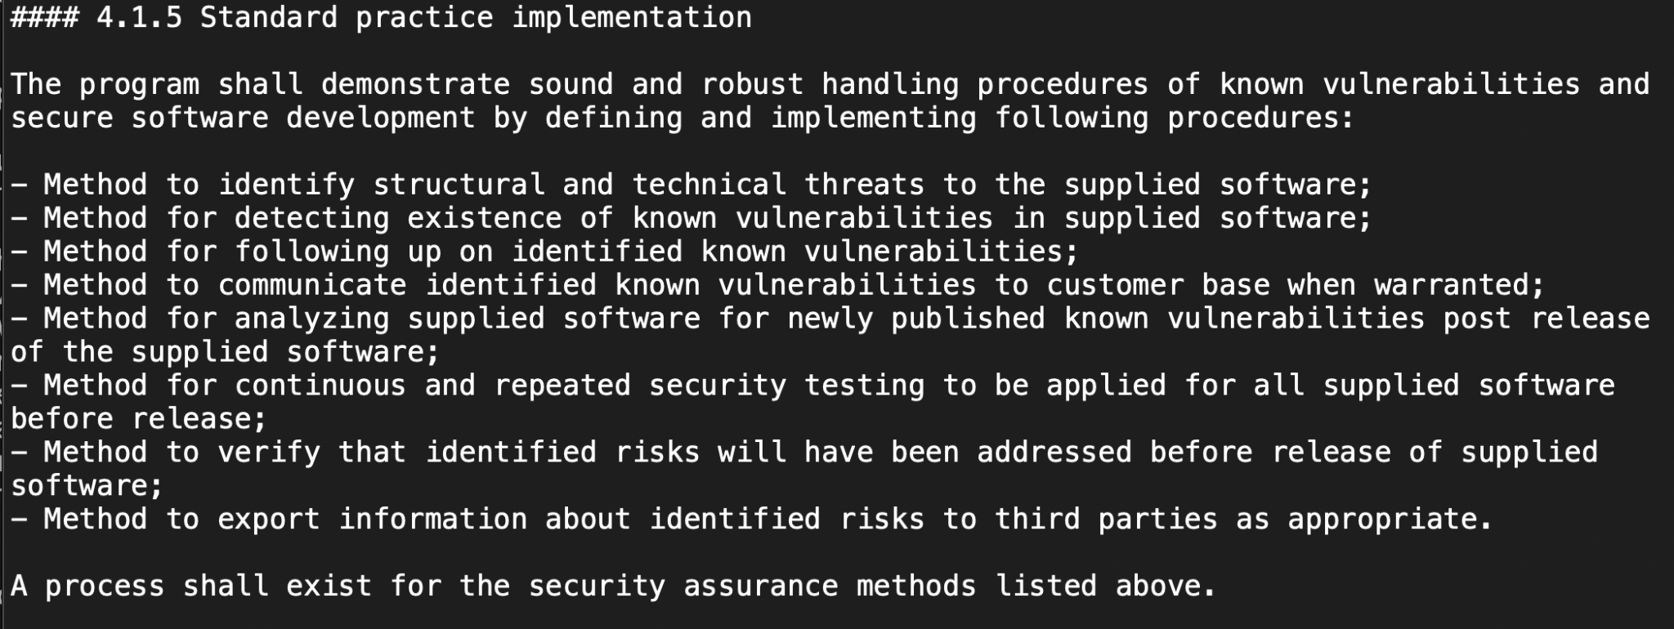
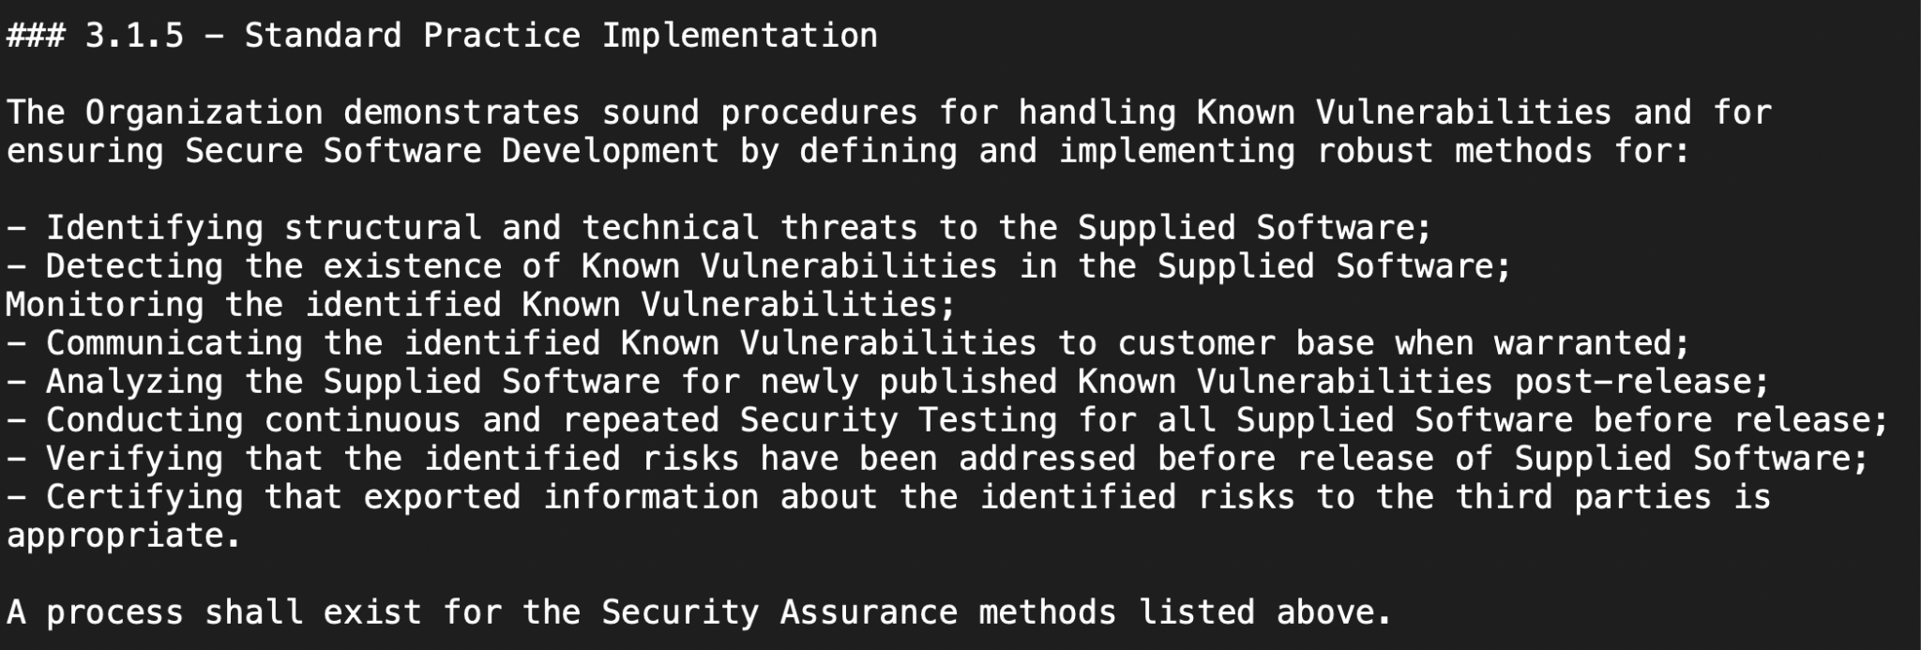
Suggestion #1 for ISO/IEC 18974:2023

Slide 37
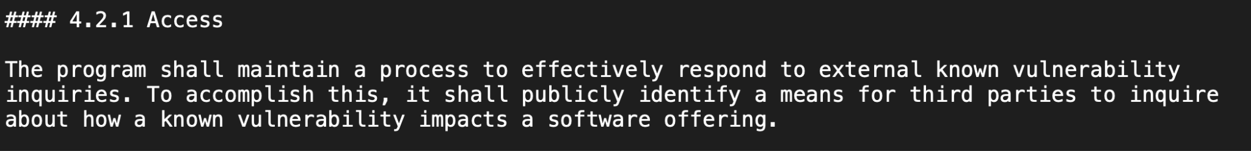
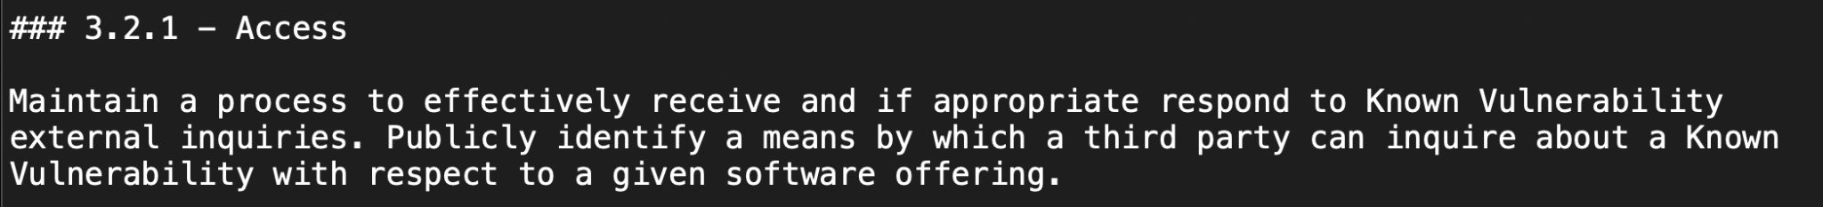
Suggestion #2 for ISO/IEC 18974:2023

Slide 38
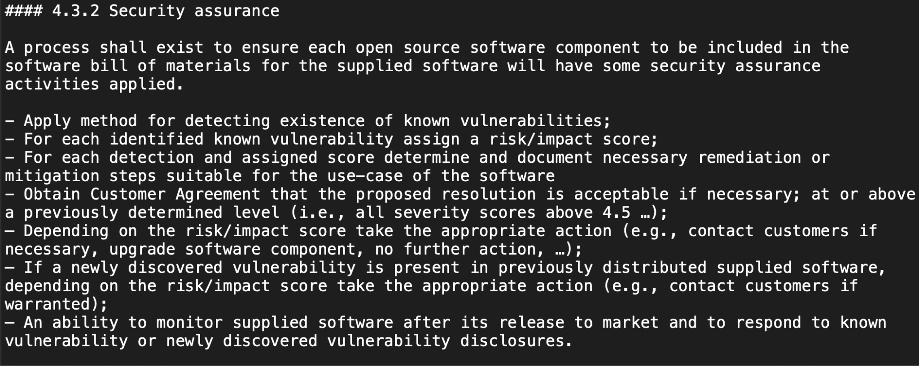
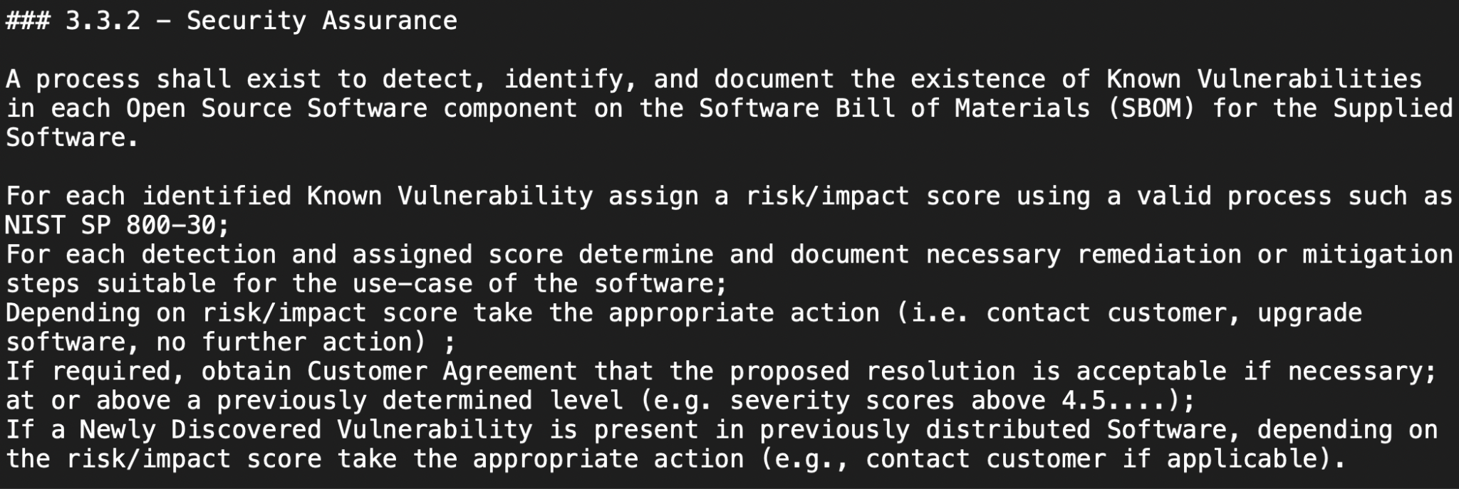
Suggestion #3 for ISO/IEC 18974:2023

Slide 39
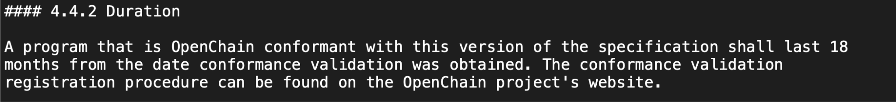
Suggestion #4 for ISO/IEC 18974:2023

Slide 40
Next Steps: Steering Committee on 2025-06-25
The Steering Committee will meet to discuss the proposed changes and make decisions about:
If the changes are accepted
When the changes (if accepted) will be included in updated versions of the standards

